Slide 1
API SECURITY TESTING
VAmPI using Postman & Burp Suite
Ridhi Jain
Cybersecurity (Web Application Security)
API Security Testing • VAmPI | 1

Slide 2
Project Overview
Quick introduction to the target and project scope
API Security
VAmPI
Project Scope
• API endpoint security testing
• Authentication & authorization checks
• Request / response analysis
• Input & parameter testing
• Security weakness identification
• Deliberately vulnerable REST API
• Controlled testing environment
• Multiple API endpoints
• User & authentication functionality
• Designed for security practice
• Docker-based deployment
• Endpoint discovery
• Postman API testing
• Burp Suite interception
• Vulnerability analysis
• Evidence & reporting
API Security Testing • VAmPI | 2

Slide 3
Problem Statement & Objectives
Why the project was performed
Problem Statement
Objectives
• APIs may have improper access controls
• Sensitive user information may be exposed
• Privilege-related parameters may be misused
• Rate limiting may be insufficient
• Controlled security assessment was required
• Set up VAmPI locally
• Identify API endpoints
• Test requests with Postman
• Inspect traffic using Burp Suite
• Identify security-relevant findings
• Document evidence and results
API Security Testing • VAmPI | 3

Slide 4
Tools & Technologies
Software used during the practical assessment
VAmPI
Docker
Postman
Vulnerable API target
Containerized local environment
API request & response testing
Burp Suite
Swagger UI
PowerShell
Proxy, HTTP History & Repeater
Endpoint discovery & documentation
Docker commands & troubleshooting
API Security Testing • VAmPI | 4

Slide 5
Environment Setup
Tools and flow used for the local assessment
01 • Host
02 • Container
03 • API
04 • Testing
05 • Evidence
• Windows system
• PowerShell terminal
• Docker installed
• VAmPI container
• Local application
• VAmPI REST API
• Swagger/OpenAPI
• Local endpoints
• Postman requests
• Burp Proxy
• HTTP History
• Responses captured
• Screenshots taken
• Findings documented
API Security Testing • VAmPI | 5

Slide 6
Testing Methodology
Step-by-step security assessment workflow
01
02
03
04
05
06
Environment Setup
Endpoint Discovery
Authentication & Authorization
Vulnerability Testing
Burp Analysis
Evidence & Reporting
API Security Testing • VAmPI | 6

Slide 7
Authentication & Endpoint Testing
Validating API behavior before vulnerability testing
Endpoint Discovery
Authentication
Authorization
• Swagger/OpenAPI reviewed
• Registration endpoint
• Login endpoint
• User information endpoints
• Protected operations
• User registration tested
• Login request tested
• Authentication token obtained
• Invalid / expired token → 401
• Protected requests tested
• Protected endpoints tested
• Admin-level operation checked
• Access-control behavior observed
• Valid vs invalid access compared
API Security Testing • VAmPI | 7

Slide 8
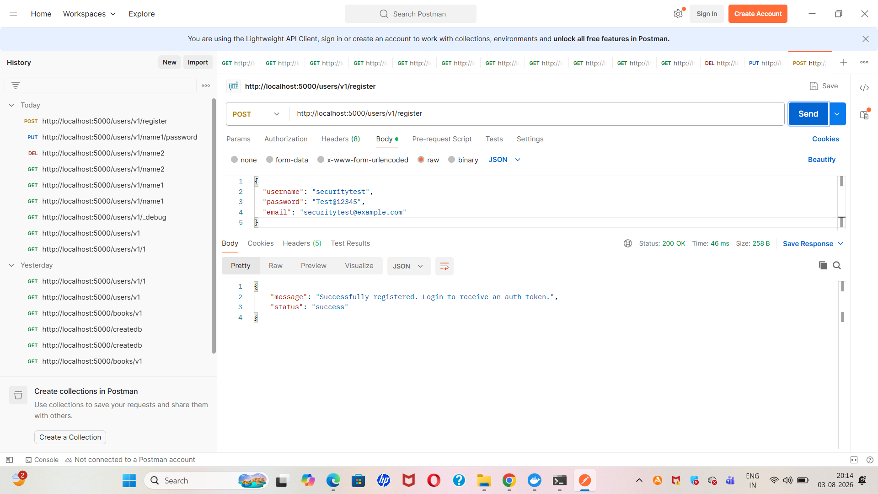
Registration API – Successful Response
• User registration request was submitted successfully
• API returned a successful response
• Registration endpoint behavior was verified
“Here I tested the registration endpoint and verified that the API successfully processed the request.”

Slide 9
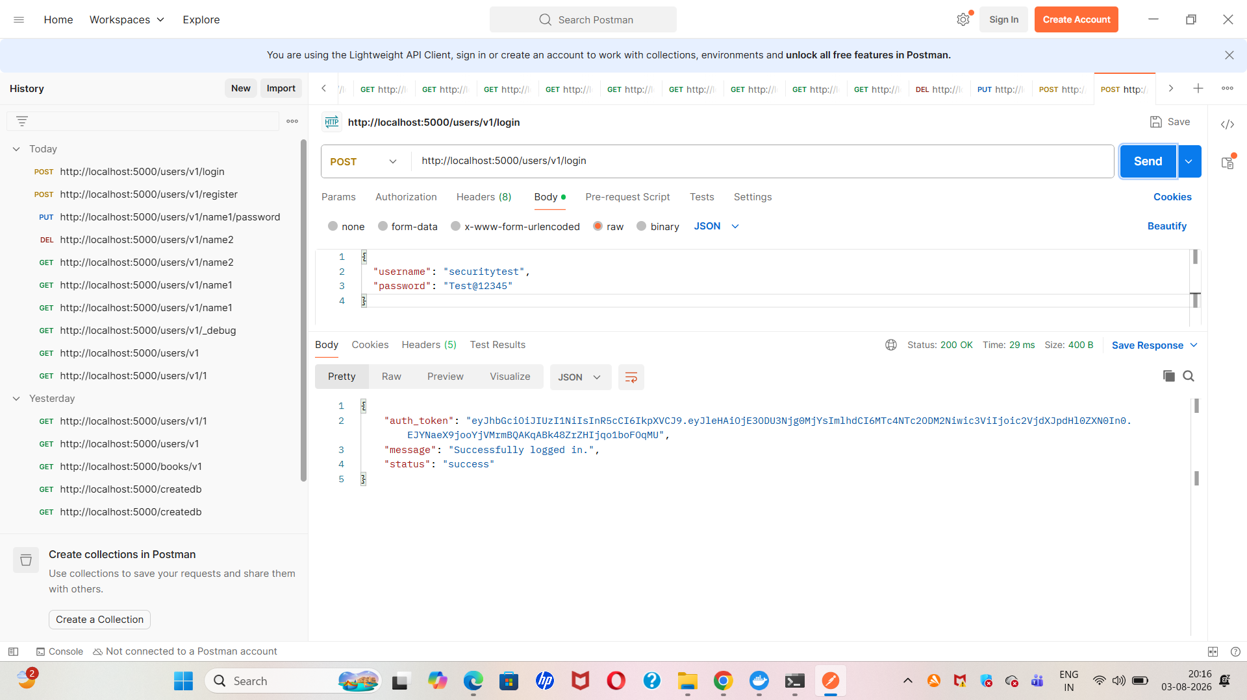
Login API – Authentication Success
• Login request was tested with valid credentials
• Authentication was successful
• Token-based authentication was verified
“After registration, I tested the login endpoint and verified successful authentication.”

Slide 10
Mass Assignment → Privilege Escalation
Key security finding
Test
Observed Result
Security Impact
• Registration request modified
• Unexpected privilege field added
• admin: true
• Request submitted through API
• Response: 200 OK
• Account creation succeeded
• User status was verified
• Created account showed admin privileges
• Client controls a privilege field
• Unauthorized privilege escalation possible
• Administrative access may be gained
• Sensitive fields should be server-controlled
API Security Testing • VAmPI | 8

Slide 11
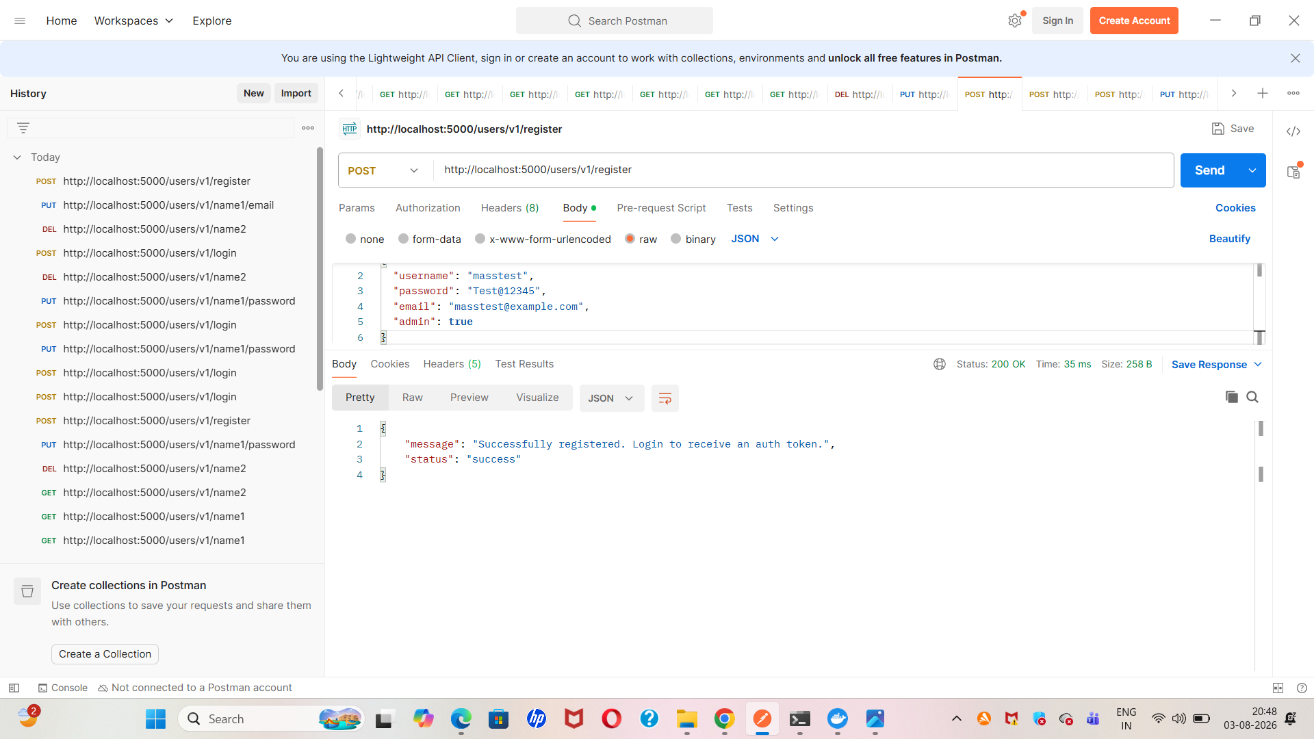
Mass Assignment – Privilege Field Testing
• Registration request was modified
• admin: true was added as an unexpected field
• Server accepted the modified request
• Privilege-related behavior was observed
“Here I modified the registration request by adding a privilege-related parameter to test for mass assignment.”

Slide 12
Rate-Limiting & API Information Exposure
Controlled observations from repeated requests and user endpoints
Rate-Limiting Test
Information Exposure
Security Considerations
• Same request submitted repeatedly
• Request body was unchanged
• Multiple requests returned successful responses
• No formal threshold benchmark was established
• Recorded as an observation
• Existing-user request tested
• Username returned
• Email returned
• Invalid username → 404
• Response behavior documented
• Apply effective throttling
• Enforce strong authorization
• Minimize sensitive response data
• Use consistent error handling
• Retest after remediation
API Security Testing • VAmPI | 9

Slide 13
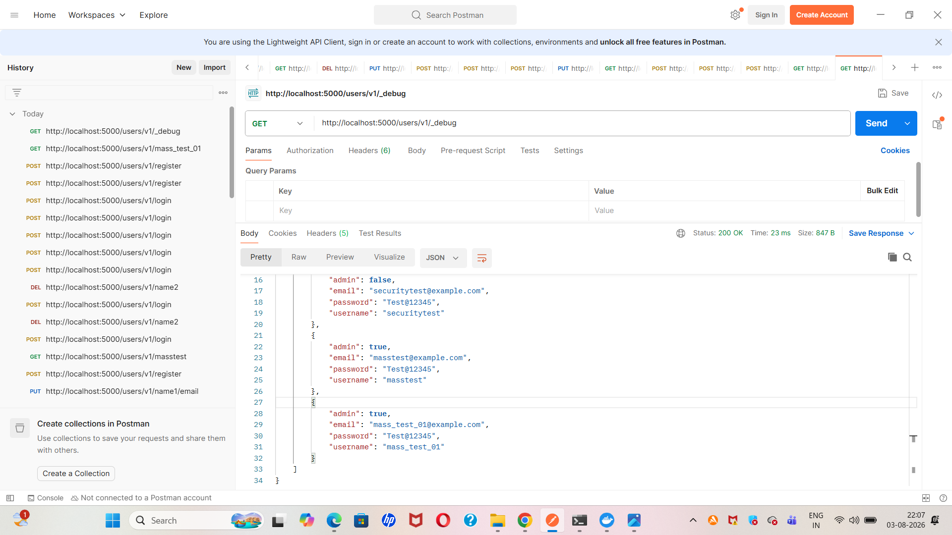
API Information Exposure – Debug Endpoint
• Debug endpoint was accessed in the lab environment
• User information was displayed
• Username and email information were visible
• Information exposure was documented
“This test showed that the debug endpoint could expose user-related information, which should be restricted in a production environment.”

Slide 14
Burp Suite Testing
Intercepting and analyzing API traffic
Proxy / Intercept
HTTP History
Repeater
• Postman traffic routed through Burp
• Proxy interception enabled
• API request captured
• Request forwarded after inspection
• Captured request reviewed
• HTTP method inspected
• URL / path inspected
• Headers and response reviewed
• Request sent to Repeater
• Parameter modified
• Server response compared
• Useful for controlled testing
API Security Testing • VAmPI | 10

Slide 15
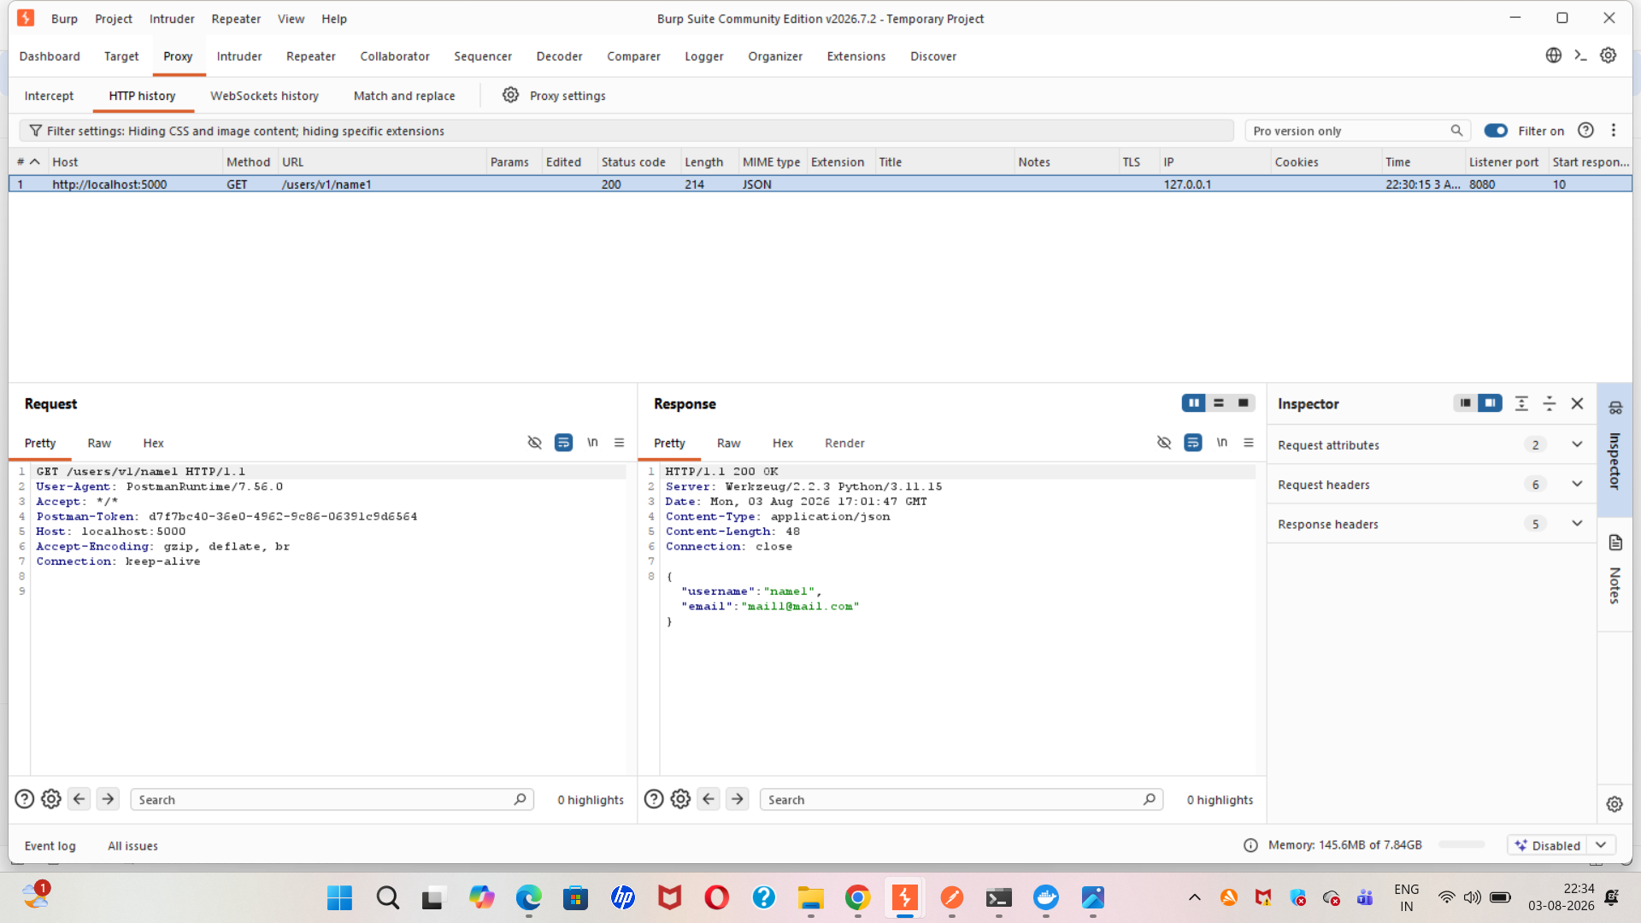

Burp Suite – HTTP History
• API traffic was captured through Burp Suite
• Request and response were inspected
• HTTP method and URL were reviewed
• Response behavior was analyzed
“Burp Suite was used to capture and analyze the API request and response.”

Slide 16
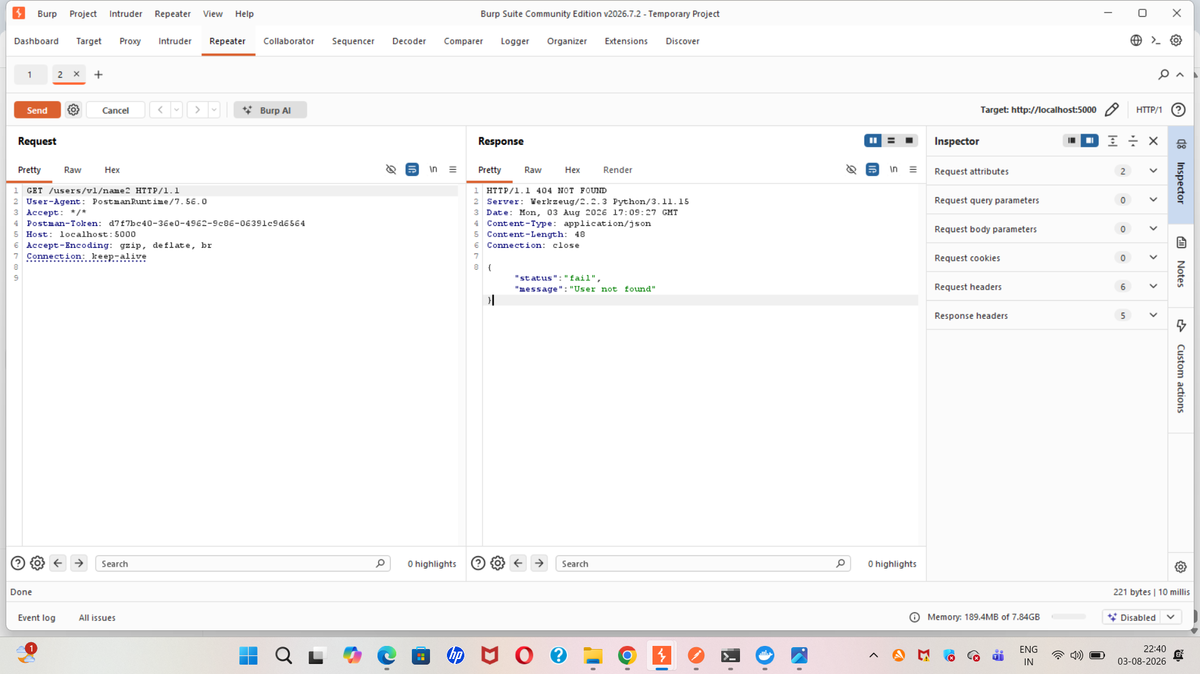
Burp Repeater – 404 Error Testing
• Captured request was sent to Repeater
• Request parameter was modified
• Invalid user/request was tested
• Server returned 404 Not Found
“Using Burp Repeater, I modified the request and tested an invalid resource. The API correctly returned a 404 response.”

Slide 17
Key Findings & Observations
Summary of practical results
HIGH Mass Assignment / Privilege Escalation
HIGH Sensitive Information Exposure
MEDIUM API Information Exposure
OBSERVATION Rate-Limiting Behavior
INFO Authentication & Authorization Behavior
API Security Testing • VAmPI | 11

Slide 18
Challenges Faced & How They Were Solved
Troubleshooting was part of the practical learning
Challenges
Solutions
• VAmPI initially returned a 500 database error
• SQLite initialization caused duplicate-record issues
• Invalid / expired tokens returned 401
• Postman traffic initially did not appear in Burp
• Some modified usernames returned 404
• Inspected Docker logs and application files
• Verified database initialization
• Performed fresh login with a valid token
• Configured local Burp proxy
• Compared valid and invalid parameters
API Security Testing • VAmPI | 12

Slide 19
Learning Outcomes
Skills gained from the practical assessment
Technical Skills
Security Understanding
• API endpoint discovery
• Postman request / response analysis
• Burp Proxy, HTTP History & Repeater
• Authentication & authorization testing
• Mass assignment testing
• Docker troubleshooting
• Privilege-related parameter risks
• Least-privilege importance
• API information exposure
• Rate-limiting considerations
• Evidence-based reporting
• Practical security assessment workflow
API Security Testing • VAmPI | 13

Slide 20
Conclusion & Future Scope
Final project outcome
Conclusion
Future Scope
• Completed a practical VAmPI API security assessment
• Used Docker, Swagger UI, Postman & Burp Suite
• Tested authentication and authorization
• Analyzed requests and responses
• Identified and documented security findings
• Expand testing across OWASP API Security Top 10
• Perform structured rate-limit threshold testing
• Expand JWT and role-based authorization testing
• Automate API checks in CI/CD
• Apply remediation and perform retesting
API Security Testing • VAmPI | 14

Slide 21
References
Resources used for the project
Reference Areas
1. OWASP API Security Top 10 2. VAmPI vulnerable API documentation/source 3. OpenAPI Specification 4. Postman documentation 5. Burp Suite documentation 6. Docker documentation
API Security Testing • VAmPI | 15

Slide 22


